Slide 1
Presentation
About me :
ENS -> MVA -> FAIR (engineer) -> FAIR (PhD 3rd year)
About my PhD :
Interested in sign matrices and tensors (graphs / multi-graphs)
Observe a few entries, predict the remaining edges
Factorization methods are simple and efficient for these problems
When is it needed to go beyond factorization methods ?
How ?

Slide 2

Artificial Neuron
Why go deep ?
Neural Networks
Introduction to Neural Networks
Notes:
use deep-learning

Slide 3
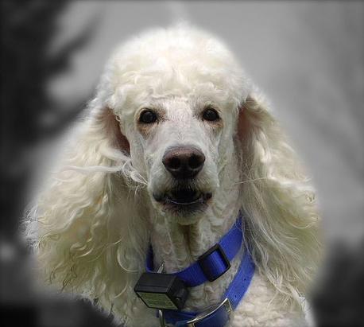

Neural Net
Examples of Inputs / Outputs
Image In, Class out
Poodle
Notes:
use network instead of arrow,
mention datasets, lots of data

Slide 4
Neural Net
Examples of Inputs / Outputs
Image In, Text out
a person on skis jumping down part of a hill

Slide 5
Neural Net
Examples of Inputs / Outputs
Text In, Text out
a person on skis jumping down part of a hill
Un skieur sautant au dessus d’un talus

Slide 6
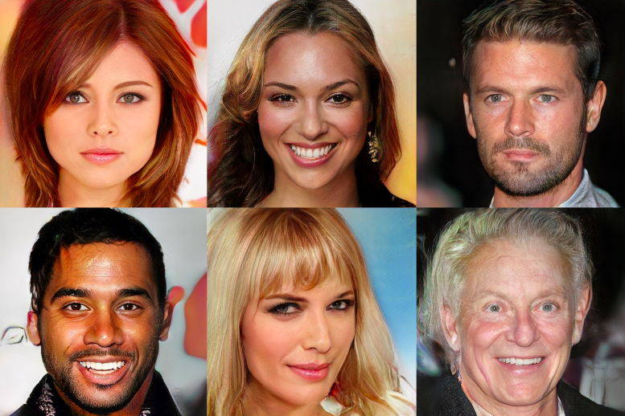
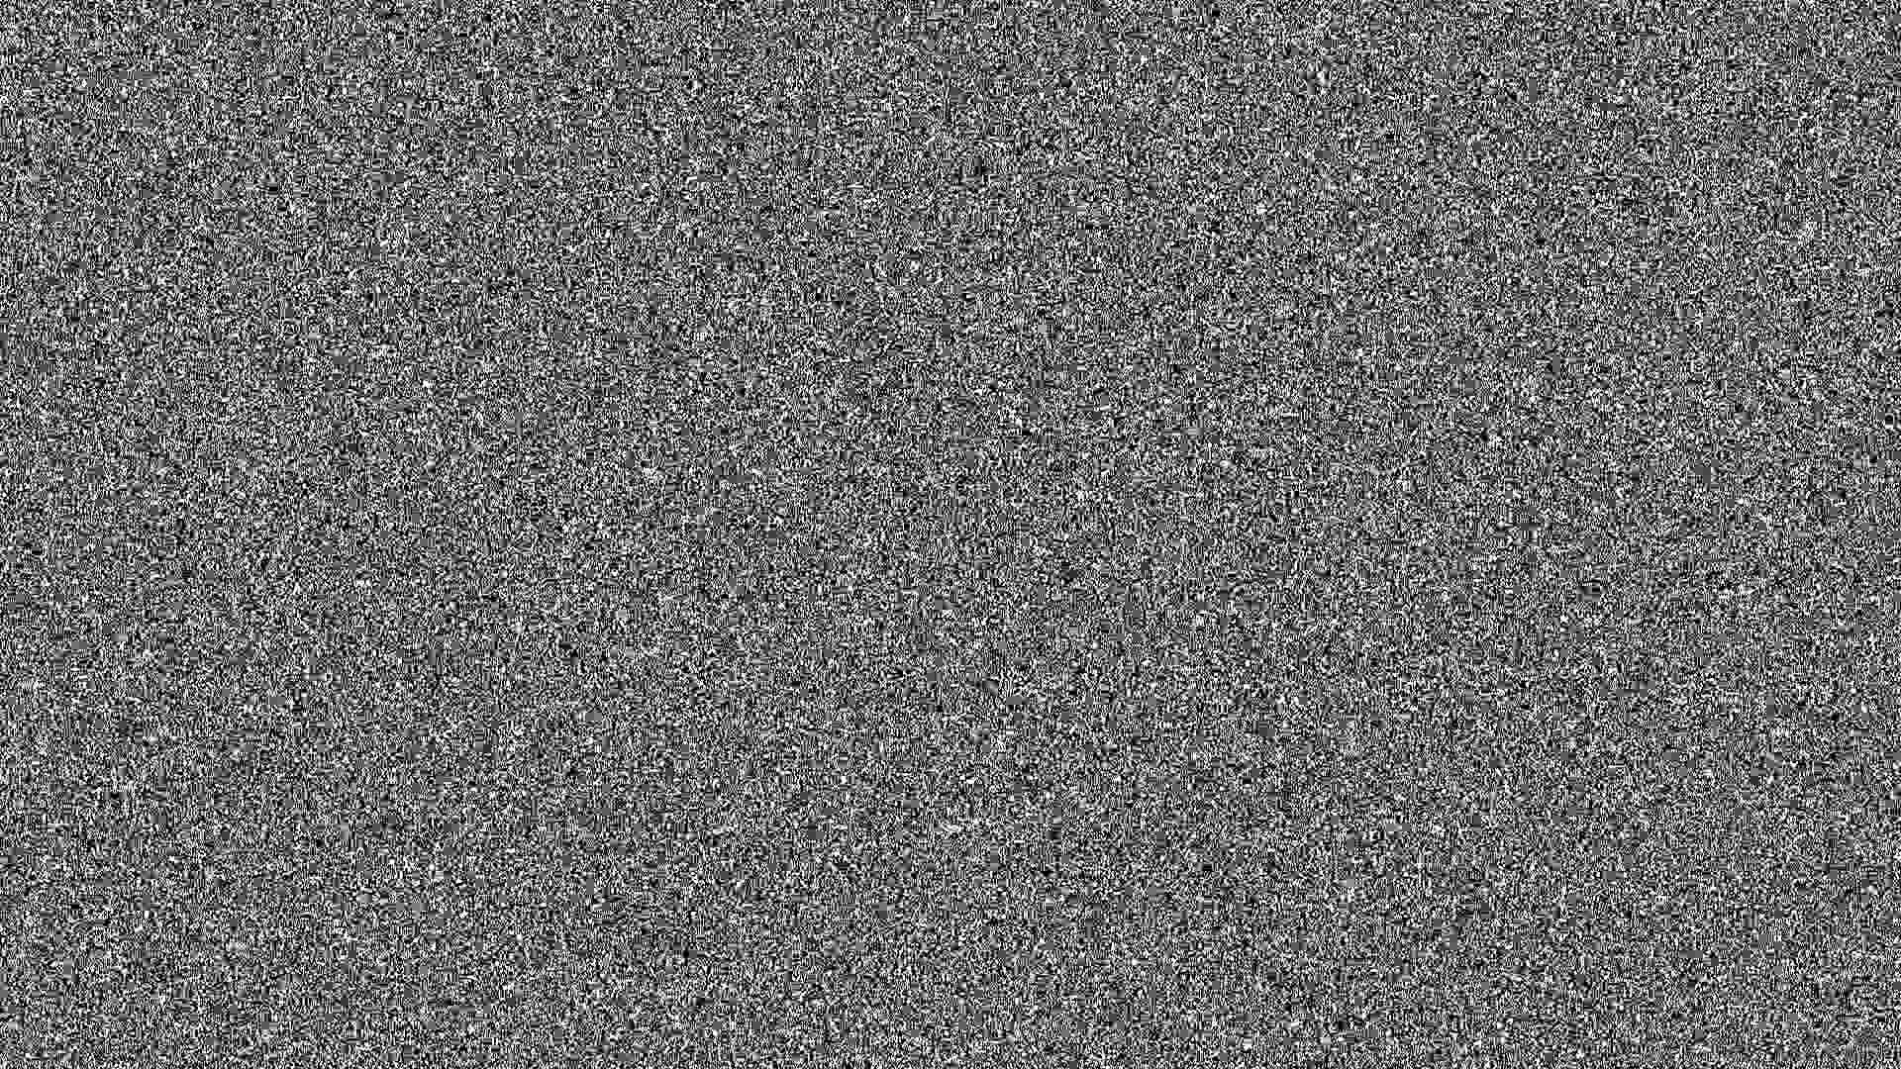
Neural Net
Examples of Inputs / Outputs
Noise In, Face out ?!
From NVIDIA’s paper at ICLR2018

Slide 7
Neural Net
Neural Networks
One model to rule them all
Hidden Layers
IN
OUT
Input Layer
Output Layer
Notes:
move the examples before

Slide 8

Neural Net
Neural Networks
One model to rule them all
IN
OUT

Slide 9

Neural Net
Neural Networks
One model to rule them all
IN
OUT
Notes:
careful with language. connected to output of previous layer.
use slide with all connections. add zoom of neuron

Slide 10


Neural Net
Artificial Neuron
The good ol’ Perceptron
bias
. . .
: Activation function
Sigmoid
ReLU
Notes:
show zoom.
Remind that x_i can be anything, image / picture.
insist on learning a / b
Add dashed line with zero, dashed line going to infinity
Add a slide to say what the inputs are
Mention we need the activation function for complexity or in the XOR

Slide 11

Neural Net
Artificial Neuron
The good ol’ Perceptron
Notes:
include sigmoid / bias.

Slide 12
Neural Net
Artificial Neuron
The good ol’ Perceptron
Notes:
include sigmoid / bias.

Slide 13

Neural Net
Artificial Neuron
The good ol’ Perceptron
Notes:
include sigmoid / bias.

Slide 14

Neural Net
Artificial Neuron
The good ol’ Perceptron
Active
Inactive
Notes:
include sigmoid / bias.
add + / - on each sides

Slide 15

Neural Net
Artificial Neuron
The good ol’ Perceptron
Notes:
include sigmoid / bias.

Slide 16

Neural Net
Why deep learning ?
We need to go deeper
Notes:
introduce why we want to do this
Add an example

Slide 17

Neural Net
Why deep learning ?
We need to go deeper
Notes:
include sigmoid / bias.

Slide 18

Neural Net
Why deep learning ?
We need to go deeper
Notes:
include sigmoid / bias.

Slide 19

Neural Net
Why deep learning ?
We need to go deeper
Notes:
put two plusses

Slide 20

Neural Net
Why deep learning ?
We need to go deeper
Notes:
include sigmoid / bias.

Slide 21
Neural Net
Hidden Layer
And in the darkness bind them
IN
OUT

Slide 22

Neural Net
Hidden Layer
Set of neurons with shared inputs

Slide 23
Neural Net
Hidden Layer
Set of neurons with shared inputs

Slide 24
Neural Net
Hidden Layer
Set of neurons with shared inputs

Slide 25
Neural Net
Hidden Layer
Set of neurons with shared inputs
Notes:
GPUS ! with orders of magnitude for speedup

Slide 26
Neural Net
Hidden Layer
Set of neurons with shared inputs
Notes:
GPUS ! with orders of magnitude for speedup

Slide 27
Neural Net
Hidden Layer
Set of neurons with shared inputs
> 100x speed-up
Notes:
GPUS ! with orders of magnitude for speedup

Slide 28

Neural Net
Forward Pass
Hmm what’s this picture …
IN
OUT
Notes:
maybe add images ??

Slide 29

Neural Net
Forward Pass
Wait for it …
IN
OUT

Slide 30

Neural Net
Forward Pass
…
IN
OUT

Slide 31

Neural Net
Forward Pass
…
IN
OUT

Slide 32

Neural Net
Forward Pass
…
IN
OUT

Slide 33

Neural Net
Forward Pass
…
IN
OUT

Slide 34

Neural Net
Forward Pass
…
IN
OUT

Slide 35

Neural Net
Forward Pass
…
IN
OUT

Slide 36

Neural Net
Forward Pass
It’s a Poodle !
IN
Poodle

Slide 37
Neural Net
Recap
The story so far
Artificial Neuron
Neural Network

Slide 38
Neural Net
Recap
The story so far
Artificial Neuron -> Thresholds its input, one is not enough
Neural Network

Slide 39
Neural Net
Recap
The story so far
Artificial Neuron -> Thresholds its input, one is not enough
Neural Network -> Computes its output with the Forward pass

Slide 40
Learning from data
Stochastic Gradient Descent
Back Propagation
Learning
”It’s all downhill from here”

Slide 41
Learning
Learning From Data
Step 1 – Get Data
A dataset is a set of (input, output)
Poodle
Shiba Inu
Shiba Inu
Not Dog
Notes:
before that introduce what a dataset is. Introduce why we need learning.
Introduce that the output of a neural net is a decision function

Slide 42
Learning
Learning From Data
Step 2 – Get More
A dataset is a set of (input, output), lots of them
Notes:
before that introduce what a dataset is. Introduce why we need learning.
Introduce that the output of a neural net is a decision function

Slide 43
Learning
Loss Function
Define your goal
Loss function

Slide 44
Learning
Loss Function
Define your goal
Loss function
Model prediction

Slide 45
Learning
Loss Function
Define your goal
Loss function
Model prediction
Ground Truth (or label)

Slide 46
Learning
Loss Function
Define your goal
Loss function
Model prediction
Ground Truth (or label)
Poodle

Slide 47
Learning
Loss Function
Define your goal
Loss function
Model prediction
Ground Truth (or label)
The loss defines how much you pay
for answering ”Shiba” instead of ”Poodle”
Poodle

Slide 48

Learning
Loss Function
Some examples
Classification
Goal : assign class +1 / -1
Loss : based on sign agreement
Notes:
split into two slides, move before examples with + and minus, mention multi class, be clear on why L2

Slide 49

Learning
Loss Function
Some examples
Regression
Goal : learn continuous value y
Loss : based on distance
Loss : Application-dependent measure of error
Notes:
split into two slides, move before examples with + and minus, mention multi class, be clear on why L2

Slide 50
Learning
Training Loss
Let’s get to minimizing

Slide 51
Learning
Training Loss
Let’s get to minimizing
Model Parameters

Slide 52
Learning
Training Loss
Let’s get to minimizing
Model Parameters
Average over the training set

Slide 53
Learning
Training Loss
Let’s get to minimizing
Loss function
Training example
Example label
Model Parameters
Average over the training set
Notes:
introduce theta before
illustrate x_i, y_i
Insist on min
Add loss that goes down
use big N

Slide 54
Learning
Training Loss
Let’s get to minimizing
Loss function
Training example
Example label
Model Prediction
Model Parameters
Average over the training set

Slide 55
Learning
Training Loss
Let’s get to minimizing
Loss function
poodle
Model Parameters
Average over the training set

Slide 56
Learning
Training Loss
Let’s get to minimizing
Find the parameters that minimize the average loss on the training set

Slide 57
Learning
An iterative process
Step 1 – be random
Your neural net start with random parameters
+
+
+
+
-
-
-
+
-
-
Notes:
before that introduce what a dataset is. Introduce why we need learning.
Introduce that the output of a neural net is a decision function

Slide 58
Learning
An iterative process
Step 1 – be random
Your neural net start with random parameters
+
+
+
+
-
-
-
+
-
-
Notes:
before that introduce what a dataset is. Introduce why we need learning.
Introduce that the output of a neural net is a decision function

Slide 59
Learning
An iterative process
Step 1 – be random
Training loss
Your neural net start with random parameters
+
+
iteration
+
+
-
-
-
+
-
-
Notes:
before that introduce what a dataset is. Introduce why we need learning.
Introduce that the output of a neural net is a decision function

Slide 60
Learning
An iterative process
Step 2 – be less random
Training loss
Then you’ll find that performs a bit better
+
+
iteration
+
+
-
-
-
+
-
-
Notes:
before that introduce what a dataset is. Introduce why we need learning.
Introduce that the output of a neural net is a decision function

Slide 61
Learning
An iterative process
Step 3 – be even less random
Training loss
Then you’ll find that performs even better
+
+
iteration
+
+
-
-
-
+
-
-
Notes:
before that introduce what a dataset is. Introduce why we need learning.
Introduce that the output of a neural net is a decision function

Slide 62
Learning
An iterative process
Step 4 – profit
Training loss
And finally a
+
+
iteration
+
+
-
-
-
+
-
-
Notes:
before that introduce what a dataset is. Introduce why we need learning.
Introduce that the output of a neural net is a decision function

Slide 63

Learning
Learning From Data
This classifier has zero error
Avoiding Overfitting

Slide 64

Learning
Learning From Data
This one too. How do we pick one ?
Avoiding Overfitting
Notes:
add a question mark in the space

Slide 65
Learning
Learning From Data
This one too. How do we pick one ?
Avoiding Overfitting
?
Notes:
add a question mark in the space

Slide 66
Learning
Learning From Data
This one too. How do we pick one ?
Avoiding Overfitting
Solution : Training and Validation Set
+
+
+
-
+
-
+
-
-

Slide 67
Learning
Gradient Descent
Back to minimizing
Loss function
Training example
Example label
Model Prediction
Model Parameters
Average over the training set

Slide 68

Learning
Gradient Descent
Back to minimizing
Skier’s approach to minimization : Steepest Descent
Notes:
add a target

Slide 69
Learning
Gradient Descent
Back to minimizing
Skier’s approach to minimization : Steepest Descent
”Gradient in x of f(x)”
Notes:
be more precise with the gradient, explain what the gradient is

Slide 70
Learning
Gradient Descent
Back to minimizing

Slide 71
Learning
Gradient Descent
Back to minimizing

Slide 72
Learning
Gradient Descent
Back to minimizing

Slide 73
Learning
Gradient Descent
Back to minimizing

Slide 74
Learning
Gradient Descent
Back to minimizing

Slide 75
Learning
Gradient Descent
Back to minimizing

Slide 76
Learning
Gradient Descent
Back to minimizing
Problem : How do we compute the gradient ?
Large
Complicated function (neural net)

Slide 77
Learning
Gradient Descent
Back to minimizing
Problem : How do we compute the gradient ?
Large -> Stochastic Gradient Descent
Complicated function (neural net) -> BackProp

Slide 78
Learning
Gradient Descent
Back to minimizing
Problem : How do we compute the gradient ?
Large -> Stochastic Gradient Descent

Slide 79
Learning
Stochastic Gradient Descent
Killing n
One function

Slide 80
Learning
Stochastic Gradient Descent
Killing n
The Gradient of the Average

Slide 81
Learning
Stochastic Gradient Descent
Killing n
The Gradient of the Average
= The Average of the Gradients
Notes:
don't use magic

Slide 82
Learning
Stochastic Gradient Descent
Killing n
The Gradient of the Average
= The Average of the Gradients
In expectation, for uniform j
Notes:
don't use magic

Slide 83
Learning
Stochastic Gradient Descent
Killing n
For some number of iterations :
Pick some random example
Gradient Step
Learning-rate
Notes:
write learning-rate

Slide 84
Learning
Back Propagation
Computing the gradient
Problem : How do we compute the gradient ?
Complicated function (neural net) -> BackProp

Slide 85
Learning
BackProp
Computing the gradient
Problem : How do we compute the gradient ?
Hidden Layer i

Slide 86
Learning
BackProp
Computing the gradient
Problem : How do we compute the gradient ?
Hidden Layer i
Complete Neural Network

Slide 87
Learning
BackProp
Computing the gradient
Problem : How do we compute the gradient ?
Hidden Layer i
Complete Neural Network

Slide 88
Learning
BackProp
Computing the gradient
Chain-rule :
Notes:
maybe people didn't learn that in high school
chain-rule for everything

Slide 89

Learning
BackProp
Computing the gradient
…

Slide 90
Learning
BackProp
Computing the gradient
…

Slide 91

Learning
BackProp
Computing the gradient

Slide 92
Learning
BackProp
Computing the gradient
Chain-Rule

Slide 93
Learning
BackProp
Computing the gradient
Doesn’t depend on current layer
Only depends on
Notes:
remove the 2

Slide 94
Learning
BackProp
Computing the gradient
Only depends on current layer

Slide 95
Learning
BackProp
Computing the gradient

Slide 96
Learning
BackProp
Computing the gradient
Depends on
current layer’s
structure

Slide 97
Learning
BackProp
Computing the gradient
Depends on
current layer’s
structure
Known

Slide 98
Learning
BackProp
Computing the gradient
Depends on
current layer’s
structure
Known
Already computed

Slide 99
Learning
BackProp
It’s Backwards !
Notes:
add the dots

Slide 100
Learning
BackProp
It’s Backwards !

Slide 101
Learning
BackProp
It’s Backwards !

Slide 102
Learning
BackProp
It’s Backwards !
Notes:
add transition to fuse SGD and backward

Slide 103
Learning
BackProp
It’s Backwards !
More precisely, let’s look at
Next layer gives us
We use the chain rule to compute :
- The gradient of our parameters :
- The gradient of the inputs :
Return the gradient of the inputs
Notes:
add transition to fuse SGD and backward

Slide 104
Learning
Recap
The Story so far
Training / Testing set
Loss
(Stochastic) Gradient Descent
Back-Propagation

Slide 105
Learning
Recap
The Story so far
Training / Testing set -> Required to avoid overfitting
Loss
(Stochastic) Gradient Descent
Back-Propagation

Slide 106
Learning
Recap
The Story so far
Training / Testing set -> Required to avoid overfitting
Loss -> Defines the problem you’re solving
(Stochastic) Gradient Descent
Back-Propagation

Slide 107
Learning
Recap
The Story so far
Training / Testing set -> Required to avoid overfitting
Loss -> Defines the problem you’re solving
(Stochastic) Gradient Descent -> Minimize by taking successive steps
Back-Propagation

Slide 108
Learning
Recap
The Story so far
Training / Testing set -> Required to avoid overfitting
Loss -> Defines the problem you’re solving
(Stochastic) Gradient Descent -> Minimize by taking successive steps
Back-Propagation -> A trick to compute the gradient

Slide 109
Learning
Recap
The Story so far
Pick a random example

Slide 110
Learning
Recap
The Story so far
Pick a random example poodle

Slide 111
Neural Net
Forward Pass
Hmm what’s this picture …
IN
OUT
Notes:
maybe add images ??

Slide 112
Neural Net
Forward Pass
Wait for it …
IN
OUT

Slide 113
Neural Net
Forward Pass
…
IN
OUT

Slide 114
Neural Net
Forward Pass
…
IN
OUT

Slide 115
Neural Net
Forward Pass
…
IN
OUT

Slide 116
Neural Net
Forward Pass
…
IN
OUT

Slide 117
Neural Net
Forward Pass
…
IN
OUT

Slide 118
Neural Net
Forward Pass
…
IN
OUT

Slide 119
Neural Net
Forward Pass
It’s a Shiba !
IN
Shiba

Slide 120
Neural Net
Forward Pass
Wait, was it a shiba ?
IN

Slide 121
Learning
BackProp
It was a poodle !
Notes:
add the dots

Slide 122
Learning
BackProp
It was a poodle !

Slide 123
Learning
BackProp
It was a poodle !

Slide 124
Learning
BackProp
It was a poodle !
Notes:
add transition to fuse SGD and backward

Slide 125
Learning
Gradient Descent
Take a step !

Slide 126
PyTorch
Picking Hyper-Parameters
Import torch
In Practice
”How I learned to stop caring and love the Backprop”
Notes:
what we've seen so far is supervised learning

Slide 127

Learning
In PyTorch
import torch import torch.nn as nn import torch.optim as optim h = 50 net = nn.Sequential( nn.Linear(2, h), nn.ReLU(), nn.Linear(h, 1), nn.Sigmoid() ) optimizer = optim.SGD(net.parameters(), lr=1) for i in range(100): optimizer.zero_grad() output = net(X[i]) loss = nn.BCELoss(output, Y[i]) loss.backward() optimizer.step()
It’s so easy …
Notes:
maybe add a slide on pytorch, mention autodiff

Slide 128

Learning
In PyTorch
import torch import torch.nn as nn import torch.optim as optim h = 50 net = nn.Sequential( nn.Linear(2, h), nn.ReLU(), nn.Linear(h, 1), nn.Sigmoid() ) optimizer = optim.SGD(net.parameters(), lr=1) for i in range(100): optimizer.zero_grad() output = net(X[i]) loss = nn.BCELoss(output, Y[i]) loss.backward() optimizer.step()
It’s so easy …

Slide 129

Learning
In PyTorch
import torch import torch.nn as nn import torch.optim as optim h = 50 net = nn.Sequential( nn.Linear(2, h), nn.ReLU(), nn.Linear(h, 1), nn.Sigmoid() ) optimizer = optim.SGD(net.parameters(), lr=1) for i in range(100): optimizer.zero_grad() output = net(X[i]) loss = nn.BCELoss(output, Y[i]) loss.backward() optimizer.step()
It’s so easy …

Slide 130

Learning
In PyTorch
import torch import torch.nn as nn import torch.optim as optim h = 50 net = nn.Sequential( nn.Linear(2, h), nn.ReLU(), nn.Linear(h, 1), nn.Sigmoid() ) optimizer = optim.SGD(net.parameters(), lr=1) for i in range(100): optimizer.zero_grad() output = net(X[i]) loss = nn.BCELoss(output, Y[i]) loss.backward() optimizer.step()
It’s so easy …

Slide 131
Learning
In PyTorch
import torch import torch.nn as nn import torch.optim as optim h = 50 net = nn.Sequential( nn.Linear(2, h), nn.ReLU(), nn.Linear(h, 1), nn.Sigmoid() ) optimizer = optim.SGD(net.parameters(), lr=1) for i in range(100): optimizer.zero_grad() output = net(X[i]) loss = nn.BCELoss(output, Y[i]) loss.backward() optimizer.step()
It’s so easy …
Stochastic Gradient Descent

Slide 132
Learning
In PyTorch
import torch import torch.nn as nn import torch.optim as optim h = 50 net = nn.Sequential( nn.Linear(2, h), nn.ReLU(), nn.Linear(h, 1), nn.Sigmoid() ) optimizer = optim.SGD(net.parameters(), lr=1) for i in range(100): optimizer.zero_grad() output = net(X[i]) loss = nn.BCELoss(output, Y[i]) loss.backward() optimizer.step()
It’s so easy …
Set all stored gradients to zero

Slide 133
Learning
In PyTorch
import torch import torch.nn as nn import torch.optim as optim h = 50 net = nn.Sequential( nn.Linear(2, h), nn.ReLU(), nn.Linear(h, 1), nn.Sigmoid() ) optimizer = optim.SGD(net.parameters(), lr=1) for i in range(100): optimizer.zero_grad() output = net(X[i]) loss = nn.BCELoss(output, Y[i]) loss.backward() optimizer.step()
It’s so easy …
Forward pass (output from input)

Slide 134
Learning
In PyTorch
import torch import torch.nn as nn import torch.optim as optim h = 50 net = nn.Sequential( nn.Linear(2, h), nn.ReLU(), nn.Linear(h, 1), nn.Sigmoid() ) optimizer = optim.SGD(net.parameters(), lr=1) for i in range(100): optimizer.zero_grad() output = net(X[i]) loss = nn.BCELoss(output, Y[i]) loss.backward() optimizer.step()
It’s so easy …
Compute the loss

Slide 135
Learning
In PyTorch
import torch import torch.nn as nn import torch.optim as optim h = 50 net = nn.Sequential( nn.Linear(2, h), nn.ReLU(), nn.Linear(h, 1), nn.Sigmoid() ) optimizer = optim.SGD(net.parameters(), lr=1) for i in range(100): optimizer.zero_grad() output = net(X[i]) loss = nn.BCELoss(output, Y[i]) loss.backward() optimizer.step()
It’s so easy …
BackProp

Slide 136
Learning
In PyTorch
import torch import torch.nn as nn import torch.optim as optim h = 50 net = nn.Sequential( nn.Linear(2, h), nn.ReLU(), nn.Linear(h, 1), nn.Sigmoid() ) optimizer = optim.SGD(net.parameters(), lr=1) for i in range(100): optimizer.zero_grad()
output = net(X[i]) loss = nn.BCELoss(output, Y[i]) loss.backward() optimizer.step()
It’s so easy …
Gradient Step

Slide 137
Learning
In PyTorch
import torch import torch.nn as nn import torch.optim as optim h = 50 net = nn.Sequential( nn.Linear(2, h), nn.ReLU(), nn.Linear(h, 1), nn.Sigmoid() ) optimizer = optim.SGD(net.parameters(), lr=1) for i in range(100): optimizer.zero_grad()
output = net(X[i]) loss = nn.BCELoss(output, Y[i]) loss.backward() optimizer.step()
It’s so easy …
Wait what ?
Is that it ?

Slide 138
Learning
In PyTorch
It’s so easy …
import torch import torch.nn as nn class Linear(nn.Module): def __init__(self): super(Linear, self).__init__() self.A = nn.Parameter(torch.randn(hidden_size, input_size)) self.b = nn.Parameter(torch.randn(hidden_size, 1)) def forward(self, x): x = torch.mm(self.A, torch.t(x)) + self.b return x
Define Model Parameters
Notes:
remove the relu, only define nn.Linear

Slide 139
Learning
In PyTorch
It’s so easy …
import torch import torch.nn as nn class Linear(nn.Module): def __init__(self): super(Linear, self).__init__() self.A = nn.Parameter(torch.randn(hidden_size, input_size)) self.b = nn.Parameter(torch.randn(hidden_size, 1)) def forward(self, x): x = torch.mm(self.A, torch.t(x)) + self.b return x
Define Forward Pass

Slide 140
Learning
In PyTorch
It’s so easy …
import torch import torch.nn as nn class Linear(nn.Module): def __init__(self): super(Linear, self).__init__() self.A = nn.Parameter(torch.randn(hidden_size, input_size)) self.b = nn.Parameter(torch.randn(hidden_size, 1)) def forward(self, x): x = torch.mm(self.A, torch.t(x)) + self.b return x
For simple forwards,
the backward pass will be added automatically !
Notes:
add transition

Slide 141
Learning
Hyper-Parameters
AKA Those that shall not be learned
How do we pick :
Number of Layers
Number of Hidden Units
Activation Function
Loss
Learning Rate
…

Slide 142
Learning
Hyper-Parameters
AKA Those that shall not be learned
How do we pick :
Number of Layers
Number of Hidden Units
Activation Function
Loss
Learning Rate
…
We don’t know !

Slide 143

Learning
Grid Search
AKA Science !
Number of Layers
We use Grid-Searches :
10
20
30
1e-2
Learning Rate
1e-1
1

Slide 144

Learning
Grid Search
AKA Science !
Number of Layers
We use Grid-Searches :
10
20
30
Evaluate for set of hyper-parameters
Select Based on Validation Error
1e-2
Learning Rate
1e-1
1
Notes:
Validation, smaller grid

Slide 145
Learning
Recap
The Story so far
Pytorch
Grid-Search

Slide 146
Learning
Recap
The Story so far
Pytorch -> Allows us not to care too much about Backprop
Grid-Search

Slide 147
Learning
Recap
The Story so far
Pytorch -> Allows us not to care too much about Backprop
Grid-Search -> How we set Hyper-Parameters we cannot learn

